Slide 1
COVID disease
Deep learning project

Slide 2
hello!
I am
Wesam Alsohle
I am here because I want to give presentations about my Deep learning project.

Slide 3
Roadmap
Frame the problem and look to the big picture
Prepare the data.
Fine tune the final model.
1
3
5
2
4
6
Explore the data to gain insights.
Train different models.
Evaluation and solution.

Slide 4
my process is easy
Explore
data folders
&
Prepare the data
Transfer learning using pretrained models
Evaluation

Slide 5
1.
Frame the problem and look to the big picture
Image classification of Chest X Rays in one of three classes:
Normal, Virus, COVID

Slide 6
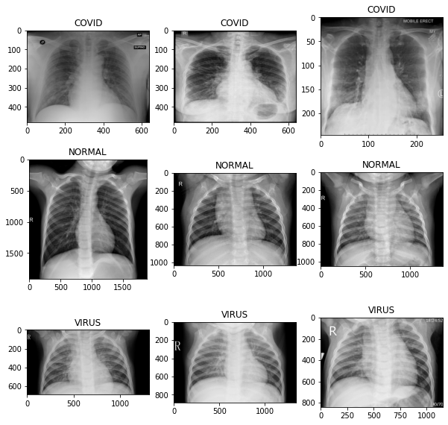
It is clear that images have different sizes!

Slide 7
2.
Explore the data to
gain insight

Slide 8
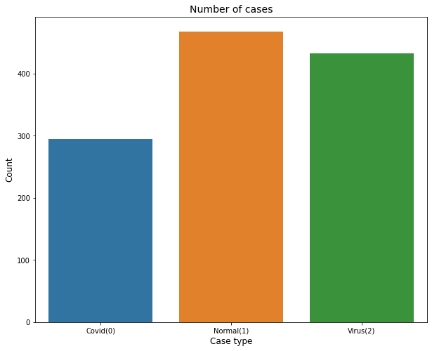
Covid: 295 Normal : 468 Virus: 433

Slide 9
3.
Prepare the data

Slide 10
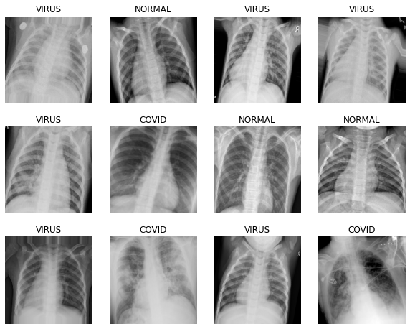
ImageDataGenerator
rescale=1./255
validation_split=0.2
shear_range=0.2
zoom_range=0.2
horizontal_flip=True
rotation_range=15
fill_mode="nearest"

Slide 11
split the data
Training set
958 Sampels
training_set = train_datagen.flow_from_directory
(train_dir,
subset='training',
target_size = (image_size, image_size),
batch_size = BATCH_SIZE,
class_mode = 'categorical',
shuffle=True)
Validation set
238 Sampels
validation_set = train_datagen.flow_from_directory
(train_dir,
subset='validation',
target_size = (image_size, image_size),
batch_size = BATCH_SIZE,
class_mode = 'categorical',
shuffle=True)

Slide 12
4.
Transfer learning Pre-Trained Models for Image Classification

Slide 13
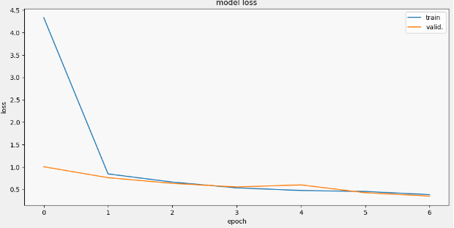
Convolutional Neural Network (Base model)

Slide 14
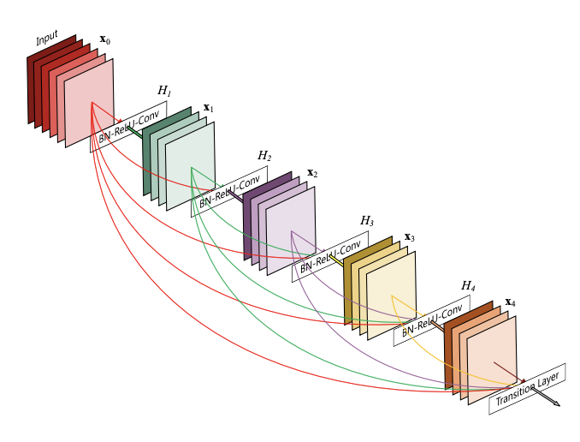
Dense Convolutional Network (DenseNet)

Slide 15
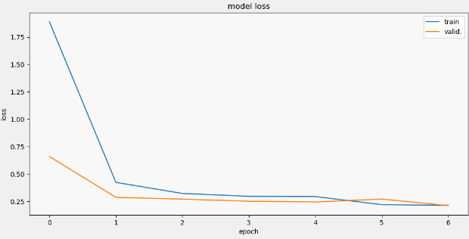
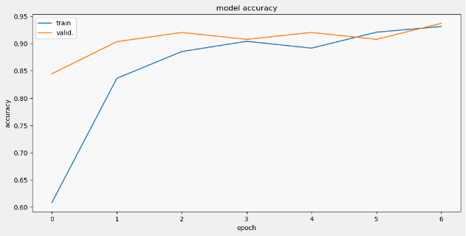
Dense Convolutional Network (DenseNet)

Slide 16
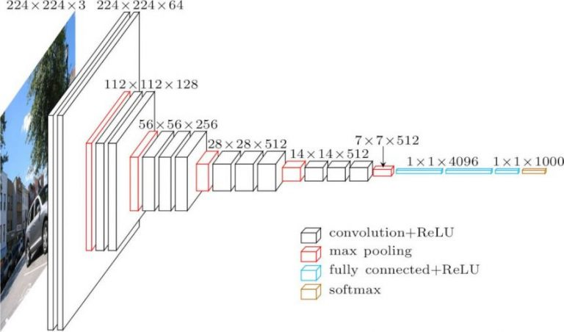
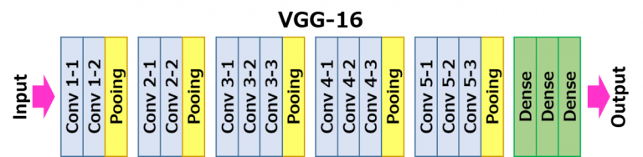
(VGG-16)

Slide 17
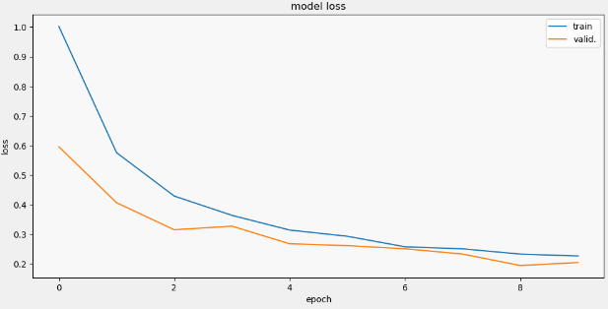
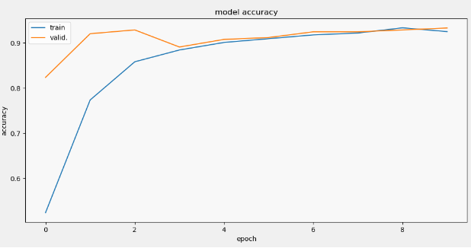
(VGG-16)

Slide 18
4.
Evaluation

Slide 19
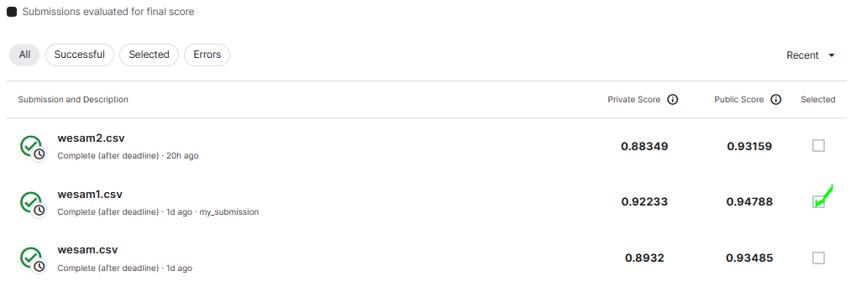
Submissions

Slide 20
thanks!
Any questions?

